Slide 1

Safeguarding Twilight

Slide 2
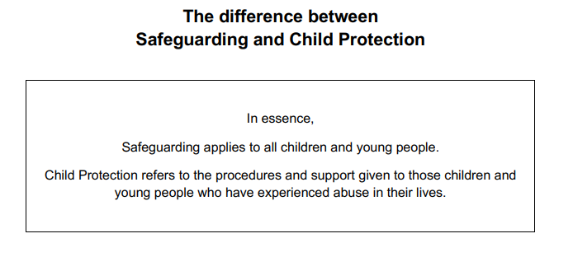

Slide 3
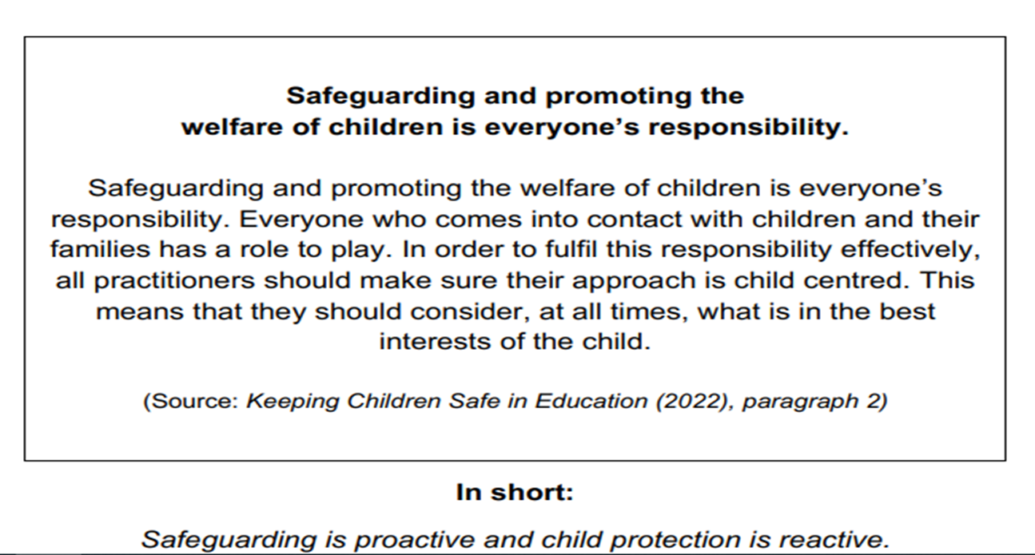

Slide 4
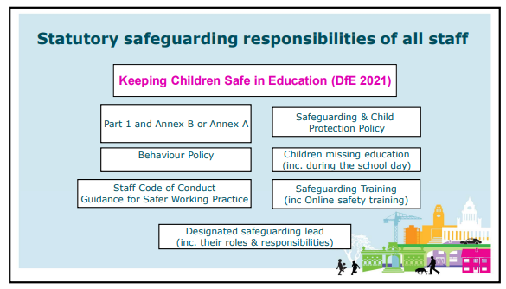

Slide 5
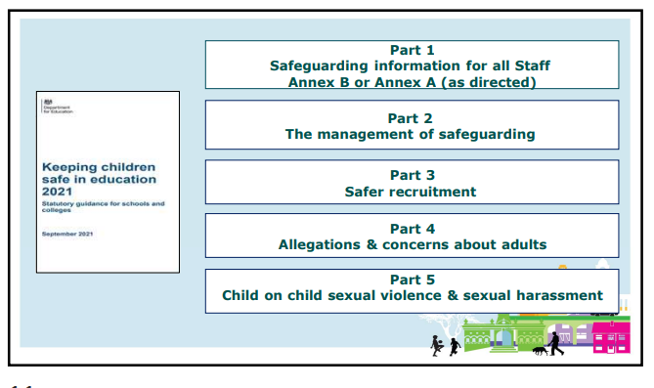

Slide 6
Part 1: Statutory guidance for schools – information for all school and college staff. Keeping Children Safe in Education (KCSIE) is statutory guidance from the Department for Education (DfE). It sets out the legal duties that govern all schools and colleges in England when carrying out their duties to safeguard and promote the welfare of children under the age of 18.
Annex A: Safeguarding information for school and college staff
Annex A is a condensed version of Part one of Keeping children safe in
education. It can be provided (instead of Part one) to those staff who do not
directly work with children, if the governing body or proprietor think it will provide
a better basis for those staff to promote the welfare and safeguard children.
Annex B: contains important additional information about specific forms of abuse and safeguarding issues. School and college leaders and those staff who work directly with children should read this annex.
As per Part one of this guidance, if staff have any concerns about a child’s welfare, they should act on them immediately. They should follow their own organisation’s child protection policy and speak to the designated safeguarding lead (or deputy). Where a child is suffering, or is likely to suffer from harm, it is important that a referral to children’s social care (and if appropriate the police) is made immediately.

Slide 7
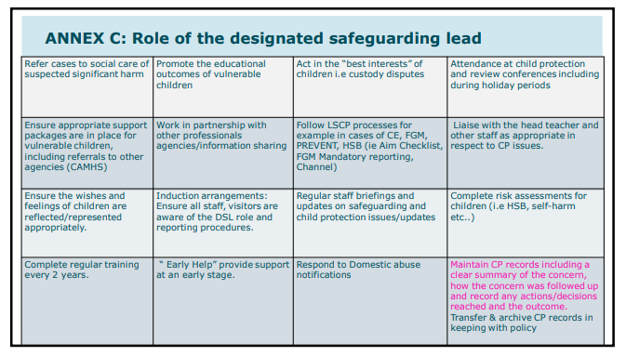

Slide 8
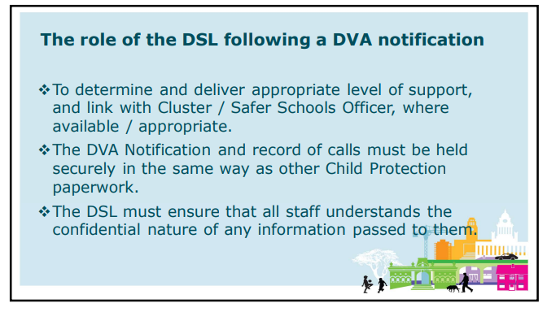

Slide 9
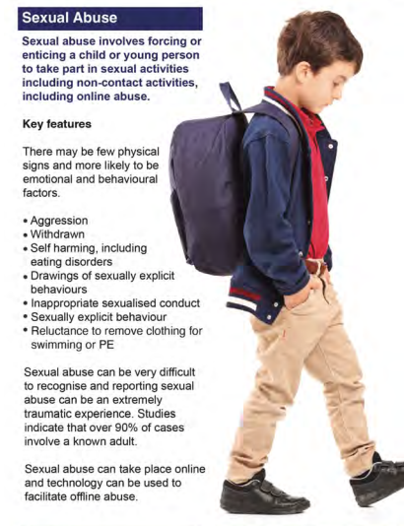
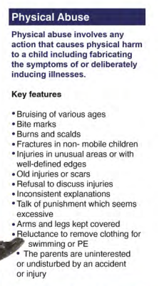

Slide 10
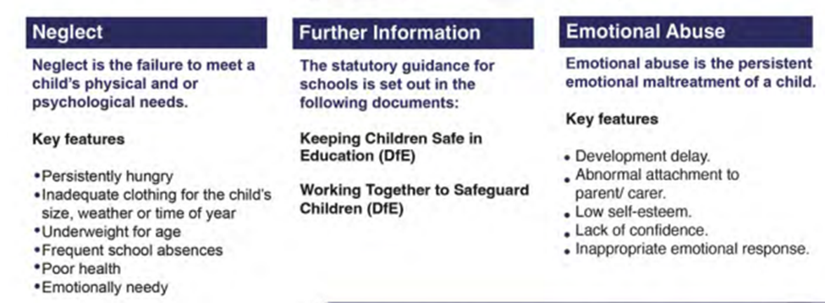

Slide 11
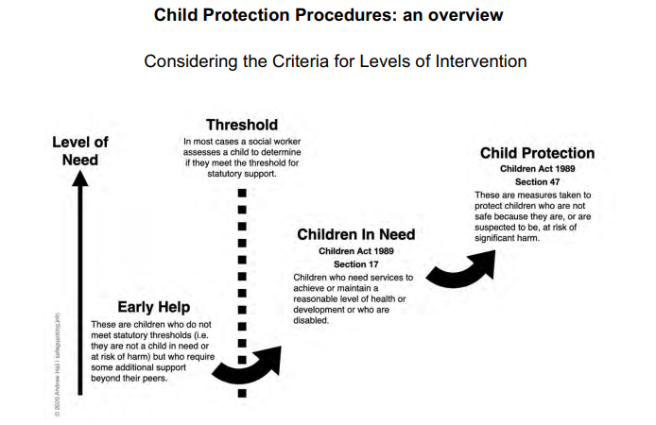

Slide 12
Safer Working Practice
It was initially issued as those working with children had expressed concern about their vulnerability and requested clearer advice about what constitutes illegal behaviour and what might be considered as misconduct. Education staff asked for practical guidance about which behaviours constitute safe practice and which behaviours should be avoided. This safe working practice document is NOT statutory guidance from the Department for Education (DfE); it is for employers, it is for employers, local authorities to decide whether to use this as the basis for their code of conduct / staff behaviour guidelines.
Adults have a crucial role to play in the lives of children.
This guidance has been produced to help them establish the safest possible learning and working environments which safeguard children and reduce the risk of them being falsely accused of improper or unprofessional conduct.

Slide 13
Underpinning principles – code of conduct
The welfare of the child is paramount
Staff should understand their responsibilities to safeguard and promote the welfare of pupils
Staff are responsible for their own actions and behaviour and should avoid any conduct which would lead any reasonable person to question their motivation and intentions.
Staff should work, and be seen to work, in an open and transparent way including self reporting if their conduct or behaviour falls short of these guiding principles.
Staff should acknowledge that deliberately invented/malicious allegations are extremely rare and that all concerns should be reported and recorded
Staff should discuss and/or take advice promptly from their line manager if they have acted in a way which may give rise to concern
Staff should apply the same professional standards regardless of culture, disability, gender, language, racial origin, religious belief and sexual orientation
Staff should not consume or be under the influence of alcohol or any substance, including prescribed medication, which may affect their ability to care for children
Staff should be aware that breaches of the law and other professional guidelines could result in disciplinary action being taken against them, criminal action and/or other proceedings including barring by the Disclosure & Barring Service (DBS) from working in regulated activity, or for acts of serious misconduct prohibition from teaching by the Teaching Regulation Agency
Staff and managers should continually monitor and review practice to ensure this guidance is followed
Staff should be aware of and understand their establishment’s child protection policy, arrangements for managing allegations against staff, staff behaviour policy, whistleblowing procedure and the procedures of the relevant Multi-agency Partnership (MAP).

Slide 14
Whistleblowing

Slide 15
Whistleblowing Policy – Leeds Model Policy
This policy sets out the principles that enable you to raise concerns about a danger, risk, malpractice or wrongdoing that affects others, without fear of adverse consequences such as harassment or victimisation.

Slide 16
Concerns to be reported under this policy may relate to something which involves an issue in the public interest and which you have reasonable belief to be true, for example where:
  • a criminal offence has been committed, is being committed or is likely to be committed;
• a person has failed, is failing or is likely to fail to comply with any legal obligation to which that person is subject;
• is against the school’s Contract Procedure Rules, Financial Procedure Rules or other policies;
• falls below established standards or practice;
• amounts to improper conduct, including serious misuse or abuse of authority;
• a miscarriage of justice has occurred, is occurring or is likely to occurs;
• the health and safety of any individual had been, is being or is likely to be endangered;
• the environment has been, is being or is likely to be damaged
• mismanagement of funds has occurred, is occurring or is likely to occur; or
• the information tending to show any of the above is being or is likely to be concealed.

Slide 17
Who to report to?
As a first step, you should normally raise concerns with your immediate manager or other appropriate manager. This depends, however, on the seriousness and sensitivity of the issues involved and who is thought to be involved in the malpractice. For example, if you believe that management is involved, you should contact the Head Teacher, the Governing Body or Internal Audit, Leeds City Council.

Slide 18
How will school respond?
The action taken by the school will depend on the nature of the concern. The matters raised may:
be investigated internally, (this is the most likely option)
be referred to the Police
be referred to the external auditor
form the subject of an independent inquiry
or any combination of the above
Within ten working days of a concern being received, where appropriate, the school will write to you.

Slide 19
Pupil Whistleblowing
This policy is to use in regard to a pupil reporting a concern with regards to knowledge or information that a pupil/ parent/ other, is carrying a knife/ weapon/ displaying other activity that could cause injury/ harm to anyone in school. It also concerns pupils/ parents/ other making threats to harm another with a knife/ weapon/ any other activity that could cause injury/ harm to anyone.
This procedure is not a substitute for normal Child Protection/ Safeguarding processes but an addition to them. Staff should always use the existing Cause For Concern (CFC) processes for raising concerns. This procedure is for the purpose of raising confidential information which protects the identity of pupils reporting concerns from others involved. The CFC is to be marked as ‘Confidential’ and staff then follow normal procedure. In the instance where people were at risk, the Police will be phoned ASAP.

Slide 20
Possible Dangers
● Knowledge / suspicion/ information/ rumour that a pupil/ pupils or others are or could be in possession of knives or weapons in school. This includes any other activity that could cause injury/ harm to others safety in school.
● Bullying with threats of violence towards yourself or other pupils involving knives/ weapons in school.
● Worries or fear for safety of yourself or others in school.
● Threats of violence towards anyone, from pupils in school involving knife/ weapons.
● Criminal activity, carrying a knife or weapon/ or drugs in school.
● Danger to Health and Safety of anyone in school.
● Child protection and/or safeguarding concerns related to knives/ weapons/ threats of violence in school OR any activity deemed a threat to oneself/ others safety.
● Unauthorised disclosure of confidential information.
● The deliberate concealment of any of the above matters.

Slide 21
Investigation and outcome
Once a pupil has raised a concern, the school will carry out an initial assessment to determine the scope of any investigation.
In most cases staff with relevant experience of investigations or specialist knowledge of the subject matter will carry out the investigation. The investigator(s) may make recommendations for change to enable the school to minimise the risk of future concerns.
However, sometimes the need for confidentiality may prevent the school from giving specific details of the investigation.

Slide 22
